Slide 1
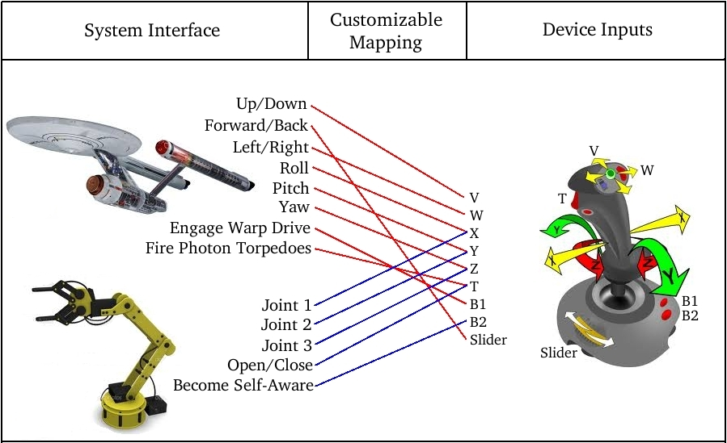
Input Device Framework
Encourages system-driven interfaces
Ensures controller compliance
Supports dynamic mapping
Allows flexible interpretation of inputs

Slide 2
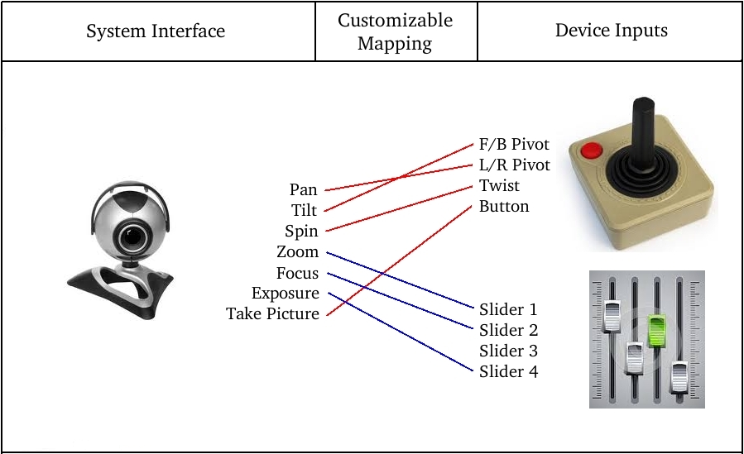
Input Device Framework
Provides for scaling, inverting, normalizing, & combining inputs
Supports mutually exclusive operation
Permits one-to-one, one-to-many, and many-to-many relationships
Fully extensible

